Slide 1
Database Architecture

Slide 2
Historical Developments
Navigational Data Models:
    Hierarchical model
    Network model
Non-navigational Data Model:
    Relational model

Slide 3
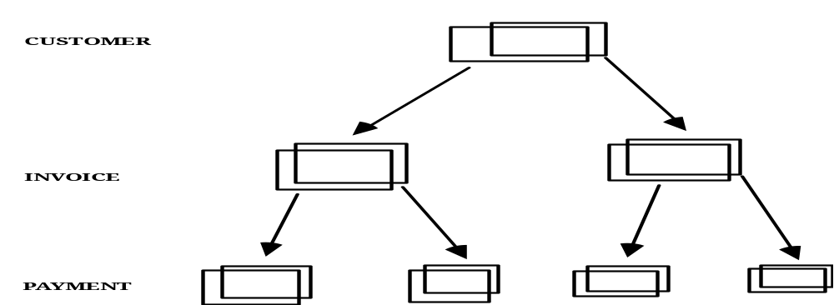
Hierarchical Model – An Example
Depends on every entity being subject to a higher one.
A simple example is geneology (each parent can be identified from the child and vice versa).
Another example of a representation of hierarchy of data is a customer invoice system:

Slide 4
Hierarchical Approach - Drawbacks
data is stored in hierarchies physically.
difficult to change structure once a particular hierarchy has been designed/formulated, making it less flexible to meet dynamic needs.
(e.g. in the customer invoice example: it's not possible to allow a single payment to be made for several invoices)
unplanned (ad-hoc) queries are difficult to support;- it may require major restructuring of the hierarchy.
The drawbacks of the hiereachical model prompted the development of the network model →

Slide 5
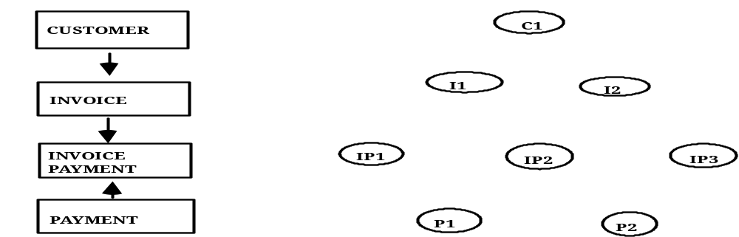
Network Model – An Example
The network model represents a more complex structure, allowing non-hierarchical structures
Within a model any record may have many immediate parents as well as many dependents, reflecting more real-world scenarios.
A network of data:- customer invoice/payment example:

Slide 6
Network Approach - Drawbacks
Data is stored in linked sets physically.
Pointer technology is used to implement relationships (with overhead, performance issues).
Unplanned queries are still difficult to support.
Programmer must be aware of 'sets' (relationships between record types) and the structural changes.
Users have to 'navigate' through the database (not a most user-friendly way to interact with the database).

Slide 7
Relational Approach - Advantages
data is stored in relations, and the relation is the only construct in the relational model.
concept of relations/attributes/tuples (similar to tables/columns/ records) is easy to understand.
contains a small set of commands in a fully defined relational query language.
no physical pointers are used for 'navigating' the database. Relationships between relations are indicated by foreign keys;- hence 'non navigational'.
logical/physical aspects of the database are clearly separated;- one of the consequences of not using physical pointers.
easy to set up and change the database by using a query language (DDL/DML)

Slide 8
ANSI/SPARC Database Model
ANSI –
The American national Standards Institute
SPARC –
Stabdards Planning and Requirements Committee
The ANSI/SPARC model is used as a general framework (benchmark) on which various architectural issues of databases can be discussed on a level-playing field.
However, this is not the only model, and not every database system matches its 'structure'.

Slide 9
ANSI/SPARC Model – 3 Levels
Consisting of 3 levels, with 3 schemas:
External level:
a collection of individual users' views of the database (the database is seen by users);- external schema.
Conceptual level:
'global' definition/description of the database in its entirety ('union' of all users views) at the logical level. It deals with information structure/content;- conceptual schema.
Internal level:
'global' definition/description of the database at the physical level. It deals with information format/physical storage;- internal schema.

Slide 10
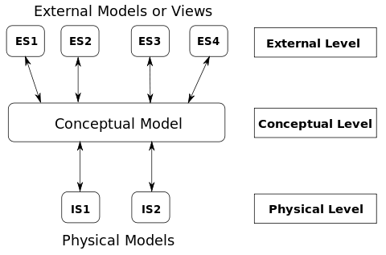
ANSI/SPARC Model – 3 Levels

Slide 11
ANSI/SPARC Model – 2 Mappings
Mapping is a process of transforming requests and results between the levels in the ANSI/SPARC model.
There are 2 mappings:
    external/conceptual mapping
    conceptual/internal mapping
Schemas and mappings are built and maintained by DBA.

Slide 12
Data Independence
The ANSI/SPARC model based on the 3 schema architecture can be used to explain the concept of Data Independence(DI). Mappings are essential to DI.
Data independence can be defined as the capacity to change the schema at one level of a database system without having to change the schema at the next higher level.
This allows users to take a logical view of the database which is independent of the way that the data is actually stored.

Slide 13
Two types
There are two types of data independence:
Logical data independence:
the capacity to change the conceptual schema without having to change any external schema.
Physical data independence:
the capacity to change the internal schema without having to change the conceptual (or external) schema.

Slide 14
Front-end / Back-end
System Architecture
End-users
front-end
queries results
back-end
page request page back
physical
database

Slide 15
Two Tier System Architecture
Tier 1 Tier 2
Database Server
Client network
DB
Presentation of data Supply data service
(client-side) (Server-side)
Functions: Functions:
- user interface - data validation
- business logic - data access
- data processing

Slide 16
Three Tier System Architecture
Tier 1 Tier 2 Tier 3
Client Application Database Server
Server
e.g. Java e.g. JDBC e.g.
applications middleware Oracle 10g
Functions: Functions: Functions:
- user interface - core business logic - data validation
- data processing - data access

Slide 17
Advantages of the 3 Tier Approach
‘thin’ client (compared to the 2-tier architecture), with less expensive hardware
reduction in client-side administration
centralised application maintenance
enhanced modularity and tier independence;- easier to modify/replace one tier without affecting others
improved load balancing of business logic, by separating core business logic from database functions.
An added advantage is that the 3-tier architecture maps quite naturally to the Web-enable database environement.

Slide 18

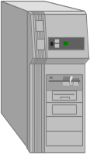

Web-enabled Database Architecture
Based on 2-tier and 3-tier architectures
All applications
installed on PC
Server software
& Database
Web
Browser
All Web applications
installed on Server
Server software
& Database
Client (PC)
Server
Client (NC)
Web Server
Server
Figure 1
Traditional 2-tier client/server
applications structure
Figure 2
3-tier Client/web server/server
Web applications structure

Slide 19
Database Languages
Data Definition Language (DDL)
facilitates the creation and description of the database
Data Manipulation Language (DML)
facilitates the manipulation and processing of data
Host Language (e.g. C#, VB, Java)
Query Language (e.g SQL)
SQL includes both DDL and DML

Slide 20
Summary
hierarchical model, network model and their drawbacks
the relational approach
ANSI/SPARC database model
data independence
evolution of system architectures
database languages

Slide 21
Bibliography
Connolly, T.M. &Begg, C.E., 2009. Database Systems: A Practical Approach to Design, Implementation and Management 5th ed., Addison Wesley. ISBN-0321523067
Date, C. J. 2004. An Introduction to Database Systems (8th ed.), Addison­Wesley, ISBN-0321197844

